Slide 1
Project 2: Toxic Comment Classification
ST538
Ruslan Mamedov, Kyle Livermore, Mitchell Below
Notes:
We designed this template so that each member of the project team has a set of slides with its own theme. Members, here’s how you add a new slide to just your set:
Mark where you want to add the slide: Select an existing one in the Thumbnails pane, click the New Slide button, then choose a layout. The new slide gets the same theme as the other slides in your set.
Careful! Don’t annoy your fellow presenters by accidentally changing their themes. That can happen if you choose a different theme from the Design tab, which changes all of the slides in the presentation to that look.

Slide 2
Introduction
Problem
Create a reliable classifier to screen online comments for toxic language
Data Source
Google/Jigsaw data file provided for Kaggle competition
Data Description
Toxic
Severe Toxic
Obscene
Threat
Insult
Identity Hate
159,571 comments
6 classifying labels
This project focuses on predicting the Toxic label, which is most prevalent in the data.

Slide 3
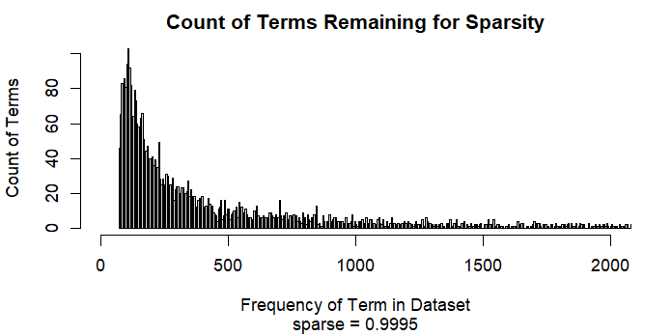
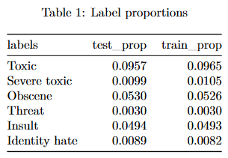
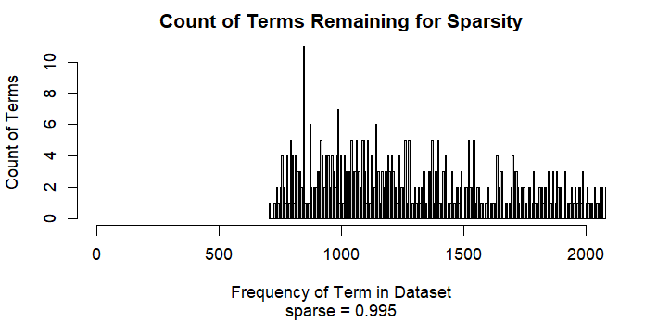
Data Preparation
Divided data into training and test sets
Compared label proportions
Converted to corpus object
Made lower case
Removed punctuation
Removed commonly occurring terms (“stopwords”) to reduce false negatives
Attempted different levels of sparsity (0.995 and 0.9995)
Lower levels of sparsity (0.9998) produced memory errors

Slide 4
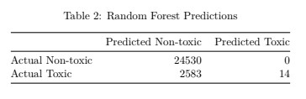
Random Forest Classifier
The time complexity to train a random forest classifier is O(T × n log(n) × m) where T is the number of trees, n is the number of samples and m is the number of features.
Tried increasing minimum node size and setting a maximum node limit to reduce the runtime. Still running classifier on the full dataset of 108,508 samples was deemed impractical (runtime around 40 minutes for the pruned tree, tunning hyper parameters - time consuming and difficult).
The random forest model correctly identified only 90.48% of the toxic comments with a high false negative rate of 99.46% (practically all the comments were predicted to be non-toxic).

Slide 5
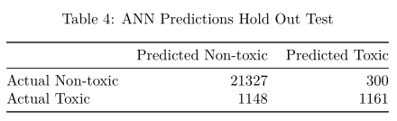
Deep Learning: ANN
We also tried using artificial neural networks (ANN) which is a form of ensemble method mirroring the neural computational models of biological neural networks.
Running the model locally was only feasible with basic one hidden layer - one neuron configuration
Using with SparkR locally still had a long runtime and didn’t make it feasible to do any kind optimization
93.95% accuracy and 49.72% false-negative rate.

Slide 6
XGBoost: Setup and Hyper-Parameters
Fastest training execution time of the models, we tried.
Further optimizations in memory utilization and sparse data set computations likely exist.
Speed allowed the expanding the number of features to 4,231 compared to 915 used by the other models
Significant hyper-parameter space that could be optimized. Due to time several large steps were tested and then additional values close to the best of the large step was also tested.
nrounds = 1000
early_stopping_rounds = 30
Number of rounds with no improvement before stopping
Objective = binary:logistic
Appropriate classification objective function
eta = 0.18
Learning rate, default = 0.3
colsample_bytree = 0.75
Proportion of columns considered for each tree. Default = 1
Subsample = 0.6
Only uses random sample proportion each round. Default = 1
max_depth = 20
Controls the max depth of decision tree used default is 6

Slide 7
XGBoost Results and Oversampling
Without oversampling
95.56% accuracy, 34.17% false negative rate
Initial Toxic label prevalence was 9.65% the unbalanced classes leads to bias in the predictions and an increased false negative rate to false positive. By oversampling 3X the predicted label prevalence was less biased.
Random selection was used to add additional copies of the comments labeled toxic
Couldn't find a R based NLP library that did Lemmatization or efficiently generated synthetic oversampling through clustering or random walk.
3X oversampling of Toxic comments
95.73% accuracy, 27.63% false negative rate
No Oversampling
 | Predicted Non-toxic | Predicted Toxic
Actual Non-toxic | 21,354 | 273
Actual Toxic | 789 | 1,520
3X Oversampling of Toxic Comments
 | Predicted Non-toxic | Predicted Toxic
Actual Non-toxic | 21,244 | 383
Actual Toxic | 638 | 1,671

Slide 8
Results
XGBoost combined with oversampling and higher sparsity produced the highest correct classification percentage and the lowest percentage of false negatives.
Random forest and neural network methods were less efficient at fitting the data and computationally expensive to run.
Method | % Correct | Type II error rate
Random Forest Classifier | 90.48% | 99.46%
Artificial Neural Network (1 layer) | 93.95% | 49.72%
XGBoost Gradient Boosted Regression Trees | 95.56% | 34.17%
XGBoost + 3X Oversampling + More Terms | 95.73% | 27.63%

Slide 9
Future Questions/Work
With more computing power, we might be able to obtain better results by:
Running XGBoost with more vocabulary
Running random forest classifier on the full data set
Running an artificial neural network with more hidden layers
We could also attempt to predict the other classifications using the methods we have already detailed.
We could also research better optimization of computational efficiency for NLP.

